Slide 1
IMPLEMENTING THE ONLINE NEWS ACT
PROPOSED GIC REGULATIONS
August 2023
Online News Act received Royal Assent June 22, 2023
Lac Laberge, Territoire du Yukon, Canada. Shutterstock

Slide 2
Online News Act Overview
The Online News Act seeks to enhance fairness and contribute to the sustainability of the Canadian news marketplace.
Establishes a Bargaining Framework
Incentivizes Voluntary
Commercial Agreements

Slide 3
Purpose of Proposed Regulatory Framework
Provide clarity for
participants
To which platforms does the Act apply?
Provide certainty on how to obtain an exemption
What is required to obtain an exemption?

Slide 4
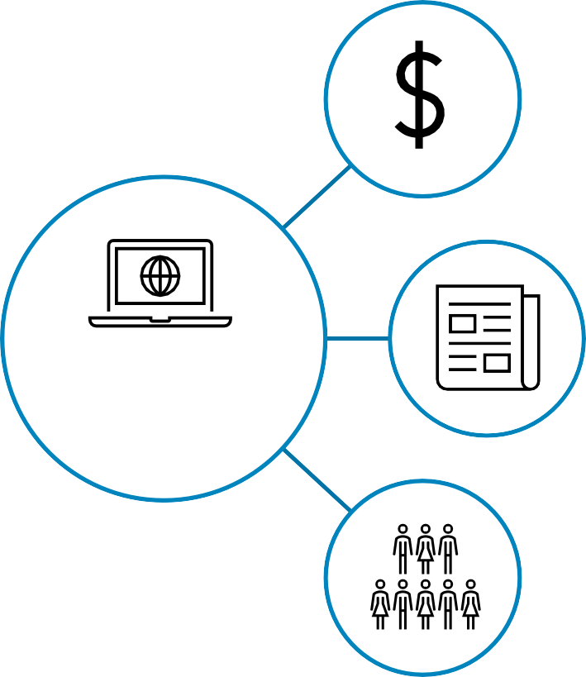
Application of the Act
total global revenue of $1 billion (CAD) or more in a calendar year
Platforms have 30 calendar days to notify the CRTC upon meeting these criteria
Operate in a search engine or social media market distributing and providing access to news content in Canada.
Platforms fall under the Act if
20 million or more Canadian average monthly unique visitors or average monthly active users

Slide 5
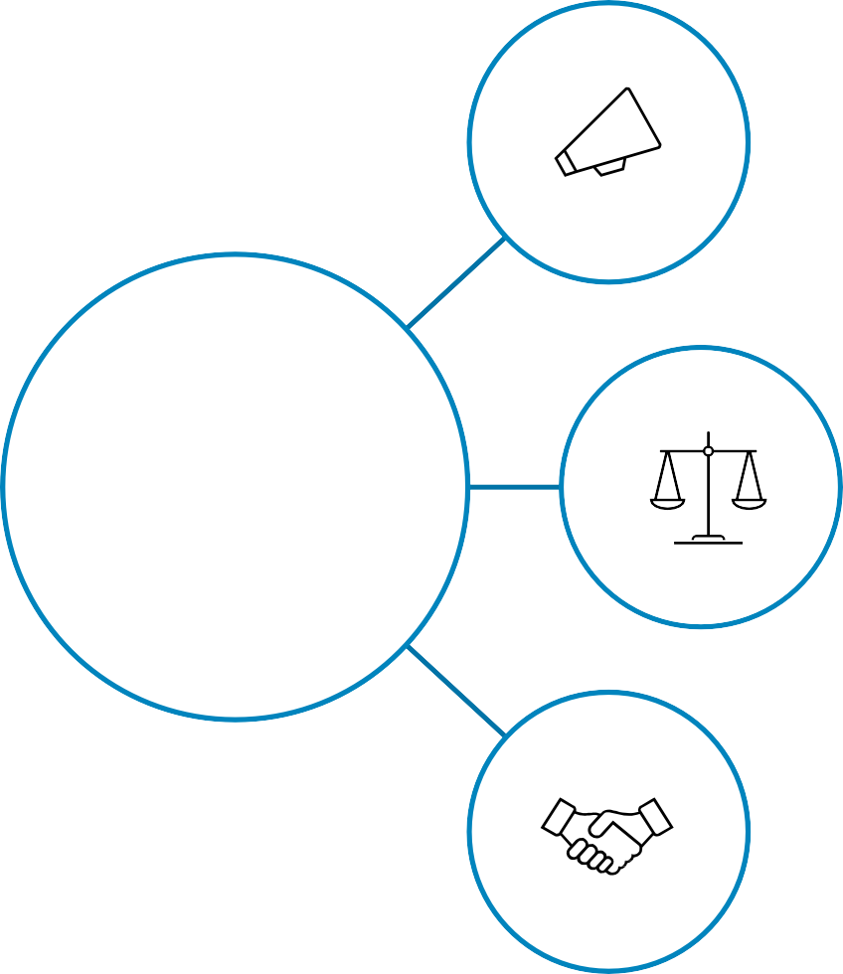
Obtaining an Exemption
Platforms must launch a 60-day open
call process
Support the Canadian News Marketplace
Agreements must respect the criteria set out in the Act and further detailed in the regulations
Compensation can include both monetary and non-monetary contributions

Slide 6
Obtaining an Exemption (cont’d)
Total compensation must exceed the amount determined by the formula
Prior agreements between intermediaries and news businesses can be considered
(Intermediary Global Revenue) × (Canadian Share of Global GDP) × (Contribution Rate [4%])
Proxy for “Intermediary’s Canadian revenue”

Slide 7
Obtaining an Exemption (cont’d)
Fair Agreements must be within 20% of average relative compensation
Agreements must commit to the production of news content.
Agreements must protect journalistic independence and the editorial process.
Agreements must include collectives of certain size representing independent local, Indigenous and official language minority community news businesses.

Slide 8
Next Steps
Canada Gazette I
RIAS and regulations
published for
comment
Consultation
30-day public
comment period on the regulations and RIAS
Canada Gazette II
Final regulations are published
Revise RIAS and regulations
Consultation to include Regulatory Impact Analysis Statement (RIAS) which communicates impact of the regulations.
Comments received will be published.

Slide 9
Annex 1: News, Information & Democracy
Digital platforms have come to play an integral role in Canada’s
news ecosystem, shifting the way Canadians access news sources.
69%
of Canadians access news online
11%
of Canadians pay for the news they access online
Online ad revenues were $14B in 2022, of which Google and Meta have a combined 80% share
474 news outlets have closed from 2008 to 2023
The production of and access to trusted news & information are key to supporting a healthy democracy and are central objectives of the Online News Act.

Slide 10
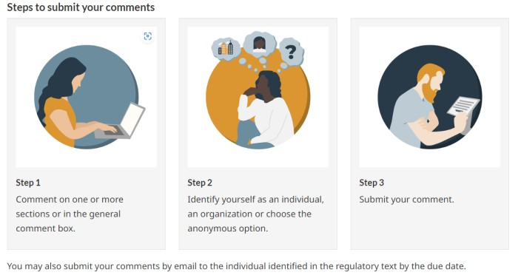
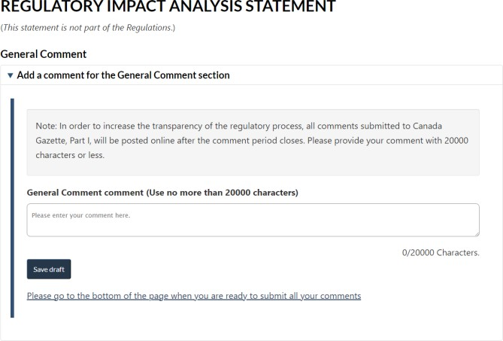
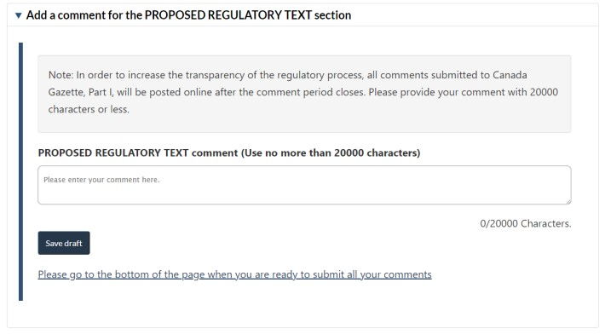
Annex 2: Providing Feedback
Feedback will be provided via the Online Regulatory Consultation System (ORCS) Comment on proposed regulations - Canada.ca (gazette.gc.ca)

